Slide 1
Chapter 9
Deflection of Beams

Slide 2
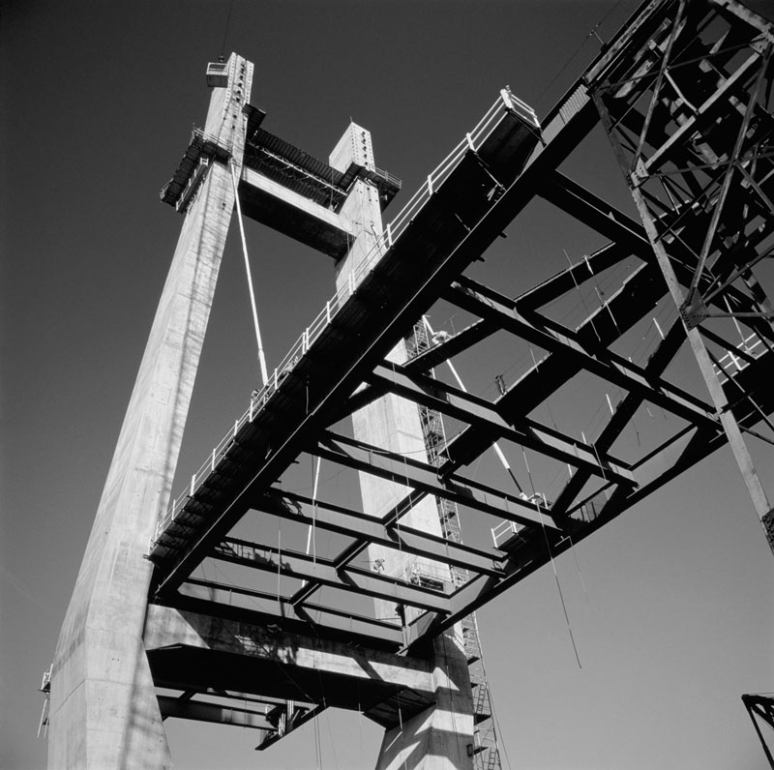
Introduction
A new aspect in the design of beams will be considered in this chapter. Previously we designed beams for strength. In this part we will consider design of beams including the maximum deflection of the beam in the design specifications.
The photo shows a cable-stayed bridge under construction. Its design is based on both strength considerations and deflection evaluations.

Slide 3
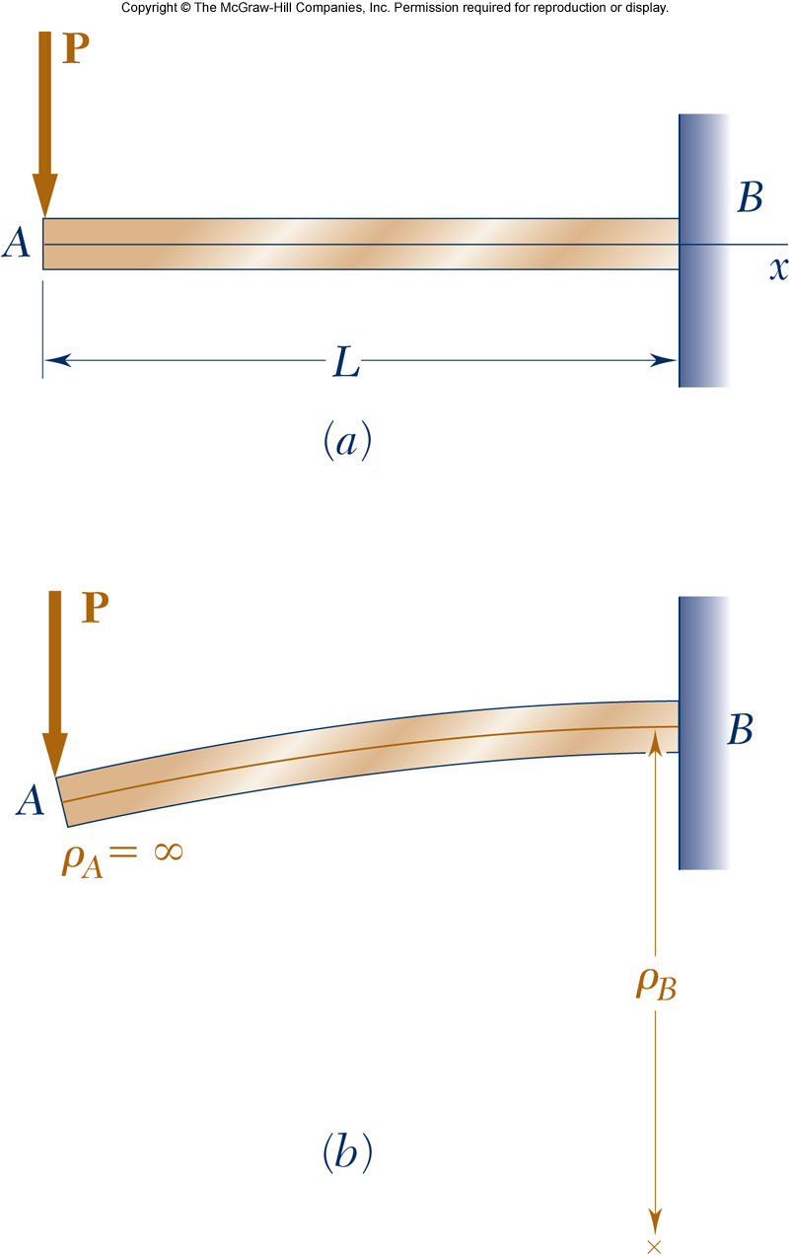
Deformation Under Transverse Loading
Relationship between bending moment and curvature for pure bending.
Example: Cantilever beam subjected to concentrated load at the free end.
Curvature varies linearly with x
At the free end A,
At the support B,

Slide 4
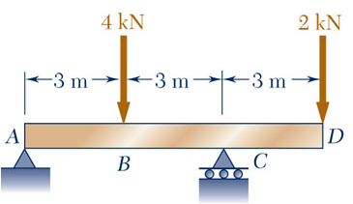
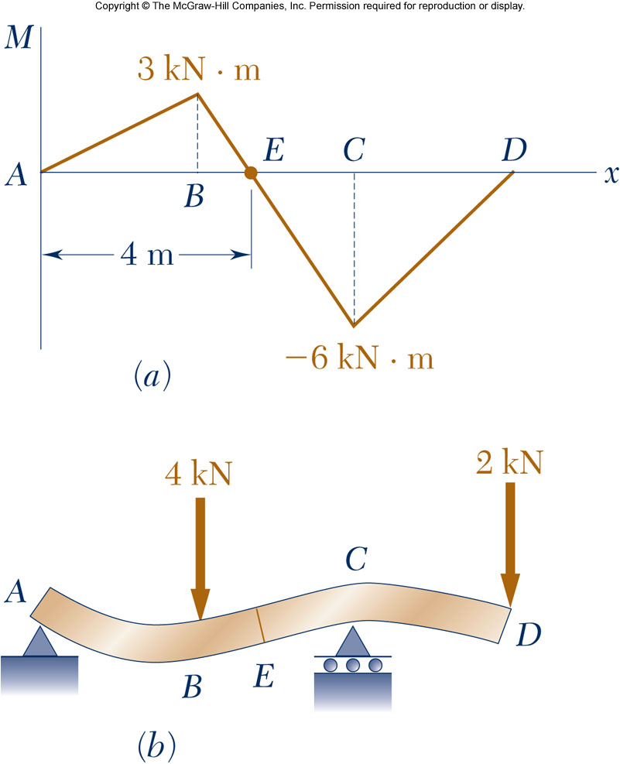
Deformation Under Transverse Loading
Example: overhanging beam.
Curvature is zero at points where the bending moment is zero, i.e., at each end and at E.
Between A and E: M(x)>0 concave upwards Between E and D: M(x)<0 concave downwards
Max moment Max curvature
An equation for the beam shape or elastic curve is required to determine maximum deflection and slope.

Slide 5
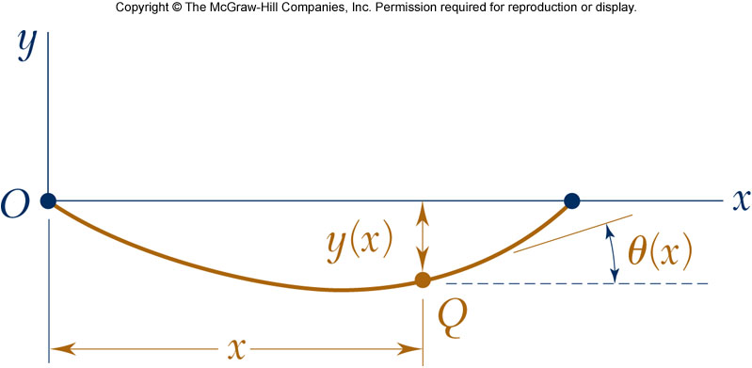
Equation of the Elastic Curve
The curvature of a plane curve at a point Q(x,y) can be written as
The governing differential equation for the elastic curve
In a beam is small
and
is the flexural rigidity

Slide 6
Equation of the Elastic Curve
Integrate the governing differential equation twice with respect to x
Beam deflection
Beam slope
The constants C₁ and C₂ are calculated from the boundary conditions

Slide 7
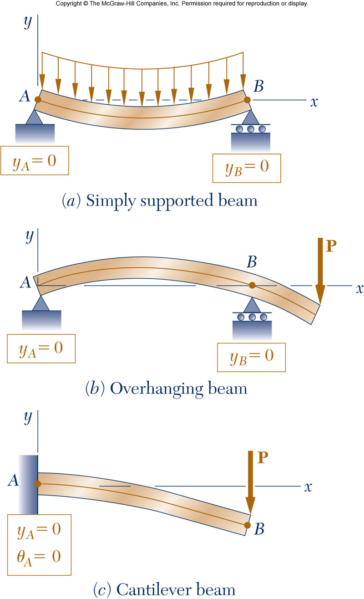
Equation of the Elastic Curve
Determination of C₁ and C₂
Three cases for statically determinant beams,
Simply supported beam
Overhanging beam
Cantilever beam

Slide 8
Example 1
9-1: For the loading shown, determine (a) the equation of the elastic curve for the cantilever beam AB, (b) the deflection at the free end, (c) the slope at the free end.

Slide 9
Example 1

Slide 10
Example 1

Slide 11
Example 2
9-8: For the beam and loading shown, determine (a) the equation of the elastic curve for portion AB of the beam, (b) the slope at A, (c) the slope at B.

Slide 12
Example 2

Slide 13
Example 3
9-15: For the beam and loading shown, knowing that a = 2 m, w = 50 kN/m, and E = 200 GPa, determine (a) the slope at support A, (b) the deflection at point C.

Slide 14
Example 3

Slide 15
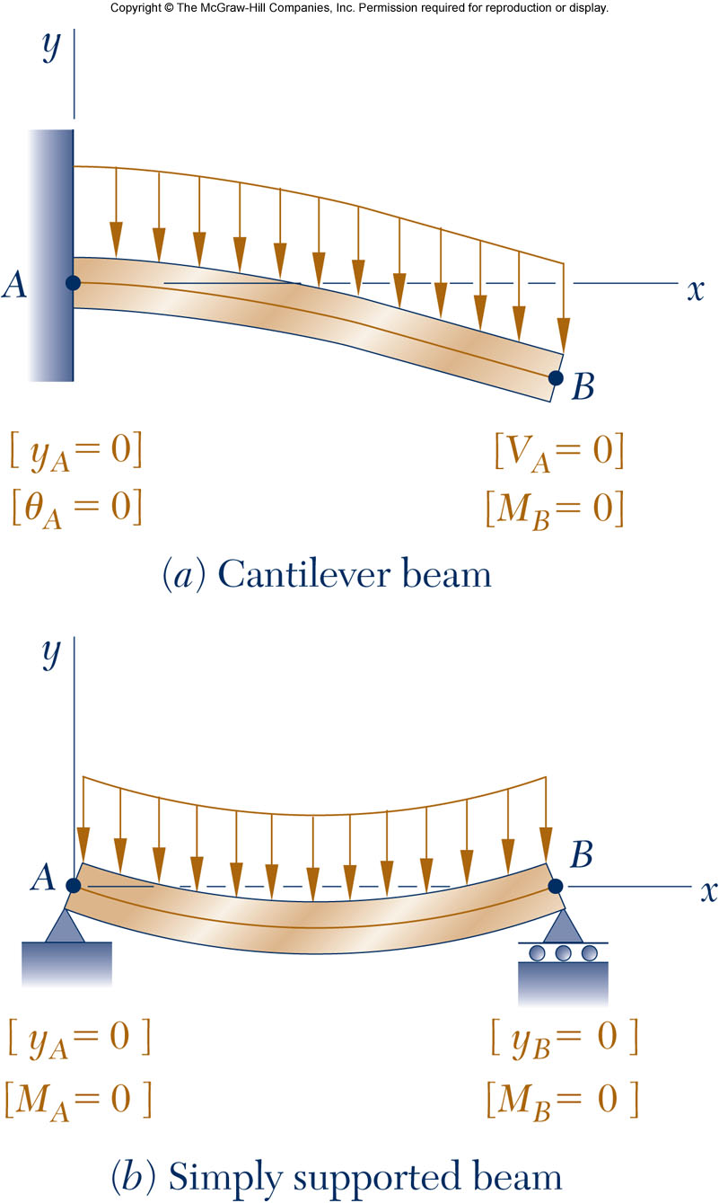
Direct Determination of the Elastic Curve
For a beam subjected to a distributed load,
Equation for beam displacement becomes
Integrating four times yields
Constants C₁, C₂, C₃ and C₄ are determined from boundary conditions.

Slide 16
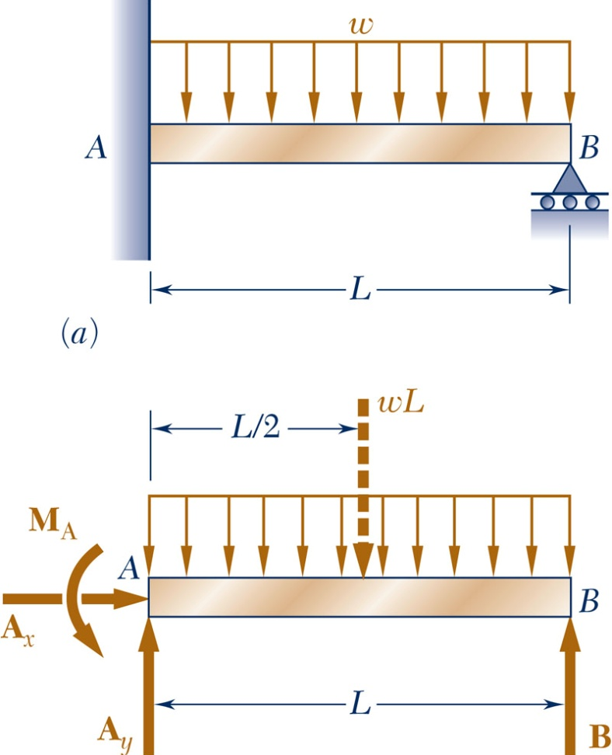
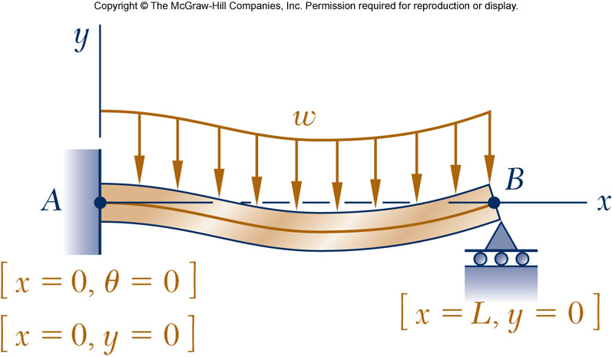
Statically Indeterminate Beams
In a statically indeterminate beam, the deflection equations are used to solve for the reactions of the beam
Conditions for static equilibrium yield
The beam deflection equations,
which introduces 2 unknowns but provides 3 additional equations from the boundary conditions:

Slide 17
Example 4
9-21: For the beam and loading shown, determine the reaction at the roller support

Slide 18
Example 4

Slide 19
Example 5
9-26: Determine the reaction at the roller support and draw the bending moment diagram for the beam and loading shown.

Slide 20
Example 5

Slide 21
Example 6
9-33: Determine the reaction at A and draw the bending moment for the beam and loading shown.

Slide 22
Example 6

Slide 23
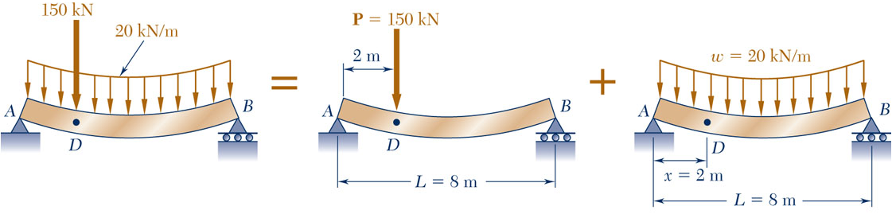
Method of Superposition
For beams subjected to several concentrated or distributed loads:
  Compute separately the deformation of each of the applied loads
  The deformation of the combined load is found by adding the
  deformation of individual loads.
Procedure is facilitated by tables of solutions for common types of loadings and supports.

Slide 24
Example 7
9-65: For the cantilever beam and loading shown, determine the slope and deflection at the free end.

Slide 25
Example 7

Slide 26
Example 7

Slide 27
Example 8
9-80: For the uniform beam shown, determine (a) the reaction at A, (b) the reaction at B.

Slide 28
Example 8

Slide 29
Example 8

Slide 30
Example 9
9-82: For the uniform beam shown, determine the reaction at each of the three supports.

Slide 31
Example 9

Slide 32
Example 9

